Slide 1



Hello!
We are Visible Fictions and we love telling stories in theatres, on screens, in parks, online, in your ears, on bikes… anywhere… everywhere.

Slide 2




Slide 3

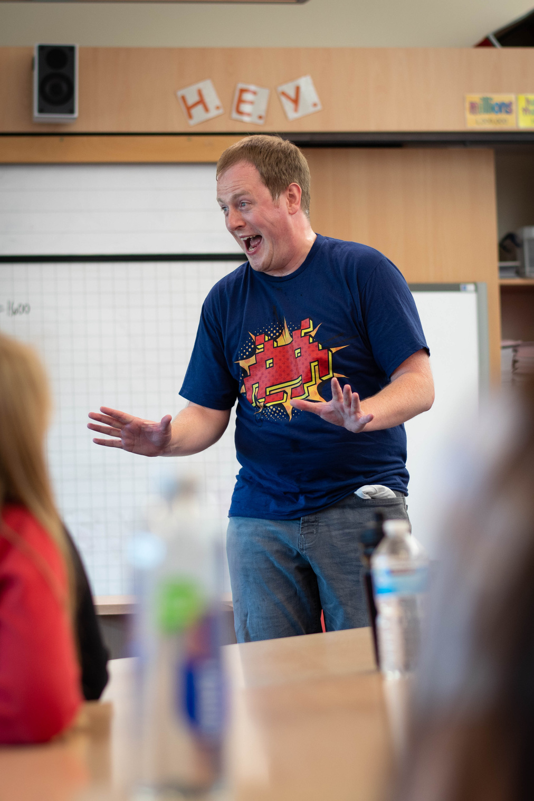
Hello
Thank you for joining Visible Fictions for our play.
We hope you enjoy learning and creating with us, and we can’t wait to hear how you get on!
1.

Slide 4
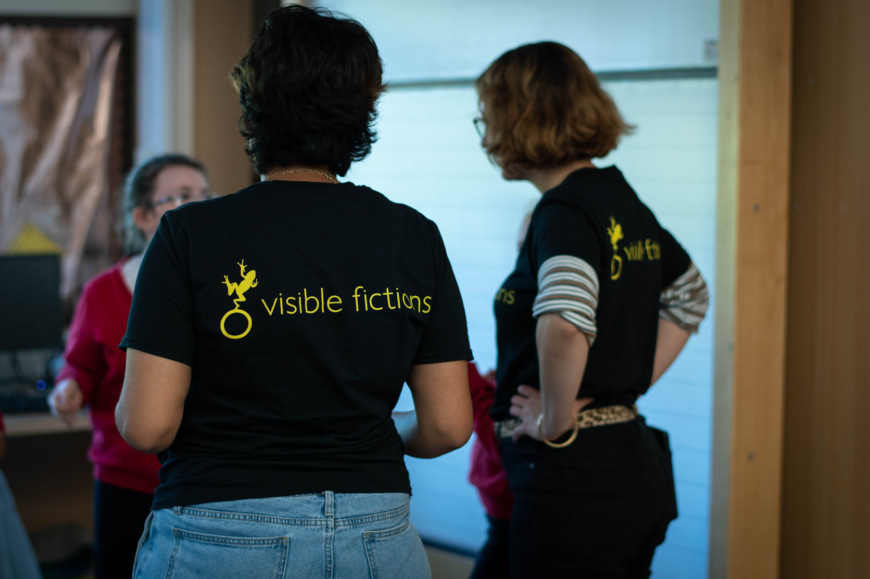
About Visible Fictions
Since 1991 we have been creating innovative and dynamic theatrical experiences and creative learning projects for young people and adults.
You can find our work in theatres, on screens, in parks, online, in your ears, on bikes… anywhere… everywhere.
We take these stories all over the world.
2.

Slide 5
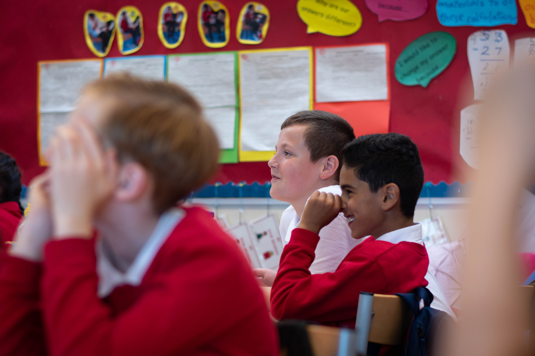
About Visible Fictions
Our aim is to get people thinking, talking, sharing and creating.
We do this by mixing things up and turning stories on their head. As a result, no two Visible Fictions shows are alike, but all guarantee an equally memorable and powerful experience.
Alongside our professional performance work, the company produces dynamic education and participation projects which enthuse all who connect to them, helping participants to discover their own artistic potential and inspire their own learning.
3.

Slide 6
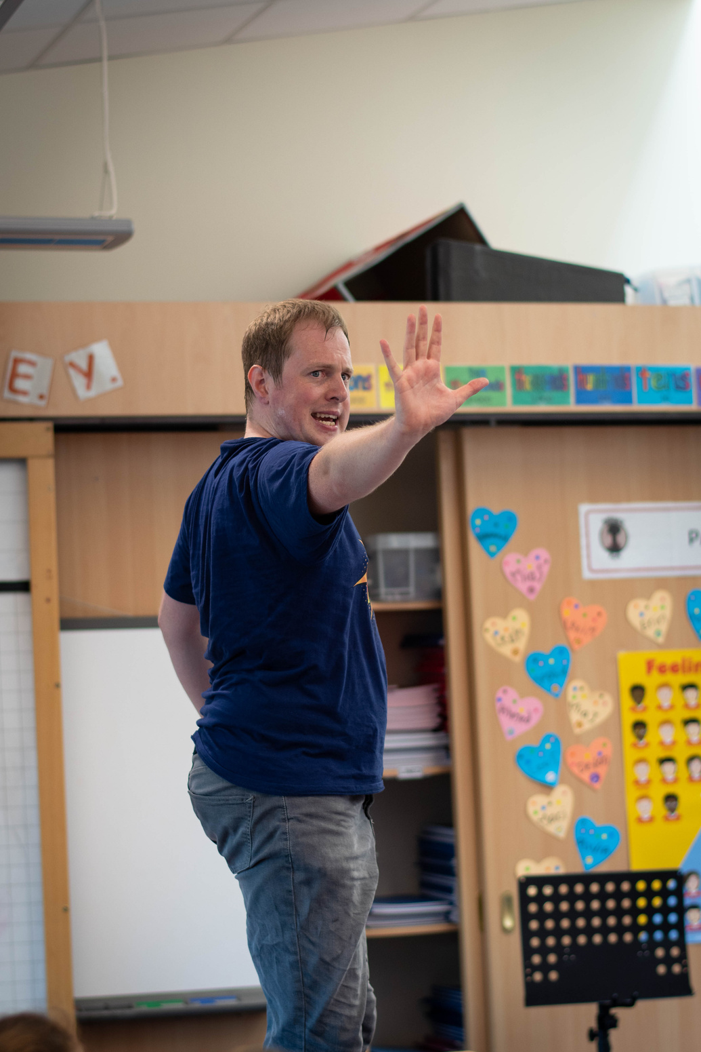
So, what’s this about?
CLUNK! . . . ....a shiny, heavy thing falls out of Andy's ear during class. What is it? He and his Gran never keep secrets from each other, but Andy makes an exception with the weird ear thing. He keeps it in his pocket – secret.
Andy lives with his Gran above her video shop. They tell each other everything, until one day they don't and bad things start to happen.
Turns out Gran has been keeping things to herself too, big, important things. Andy starts to wonder if his secret ear thing caused all this, or might it save them all?
4.

Slide 7
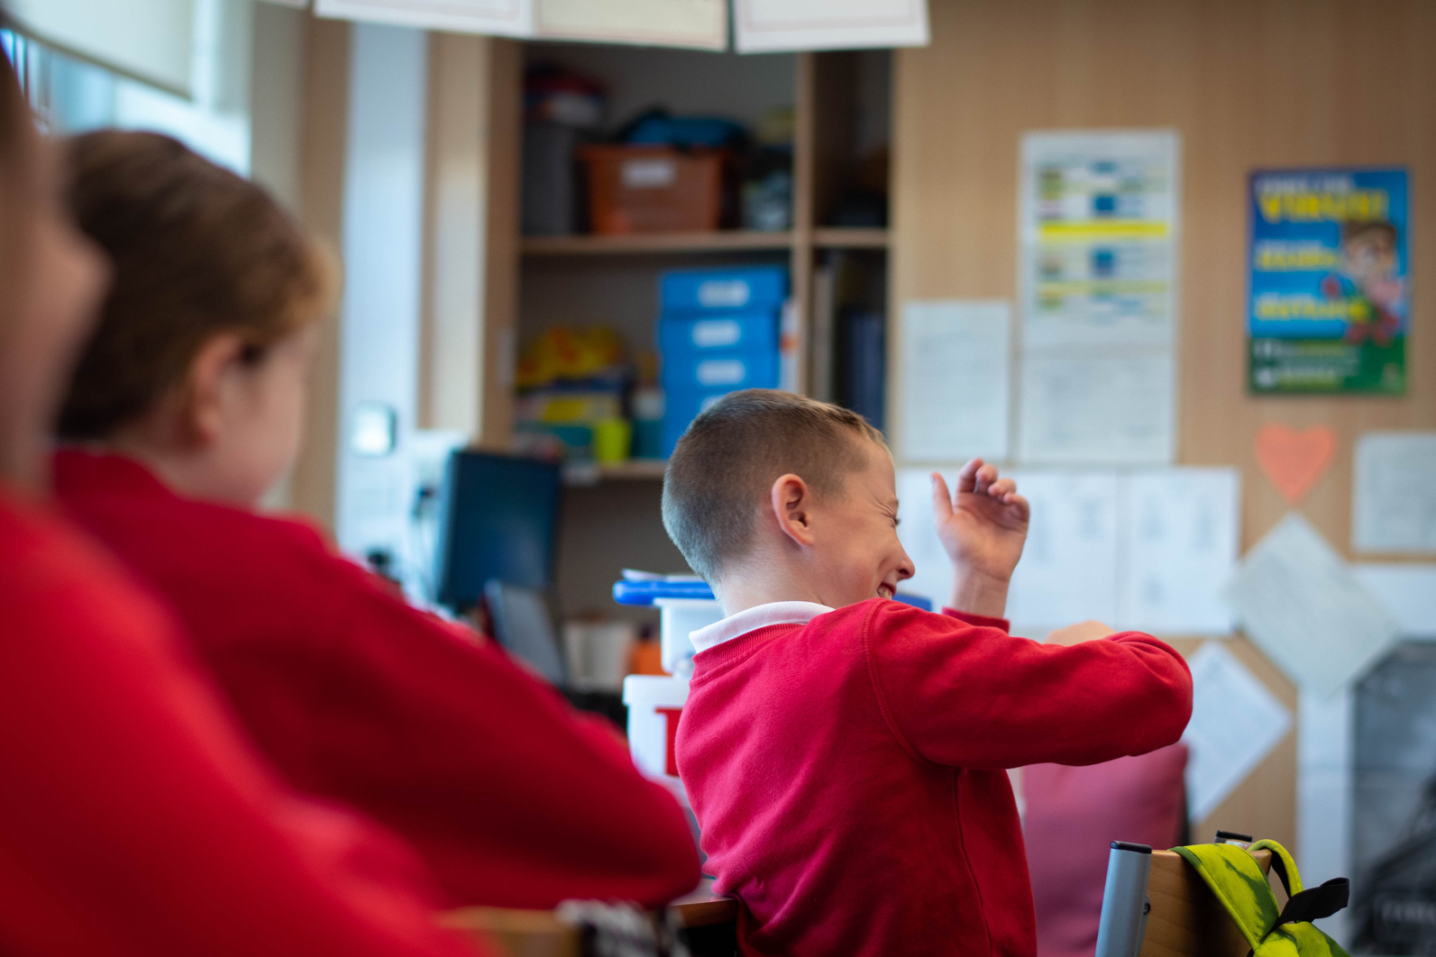
What do you want us to do?
We want you to sit back and enjoy the 50 minute performance! After that we’d love for you and your teacher to work through activities connected with the performance.
Don’t worry if you didn’t see the performance, you can still do this work.
In these activities you’re going to explore:
Storytelling
Friendship
Resilience
5.

Slide 8

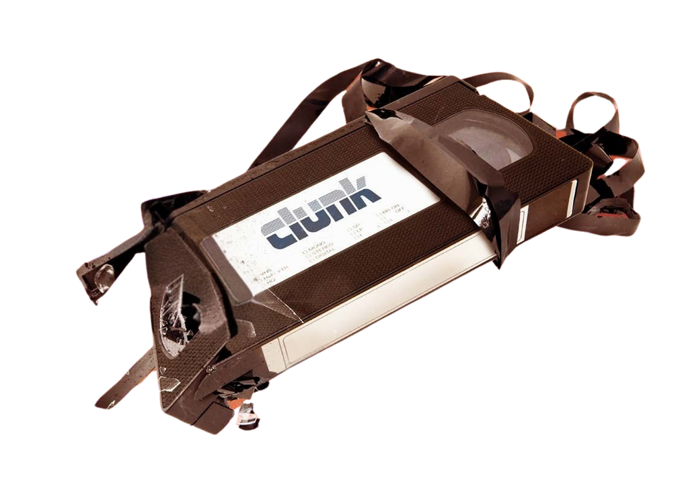

Follow us and share your work using #VFCLUNK and #VFCreativeLearning
www.visiblefictions.co.uk

Slide 9


Let’s Think & Create
Aim
To explore ways in which I can be creative and share my ideas, thoughts and opinions.
Outcome:
To share individual thoughts and opinions in written and verbal format.
To use creative thinking to problem solve.
To convey information, describe events, and combine ideas in different ways.
www.visiblefictions.co.uk

Slide 10

All About CLUNK!
Task 1
As a whole class discuss...
What do you think of when you hear the word CLUNK?
Was the show what you expected? Why? If not, what did you expect?
What did you enjoy the most about the show? Why?
What did you enjoy the least about the show? Why?
1.

Slide 11




All About CLUNK!
Task 2
In small groups or pairs, answer the following questions
CHARACTERS
PLOT
OVERALL PERFORMANCE
CHALLENGE TIME
2.

Slide 12
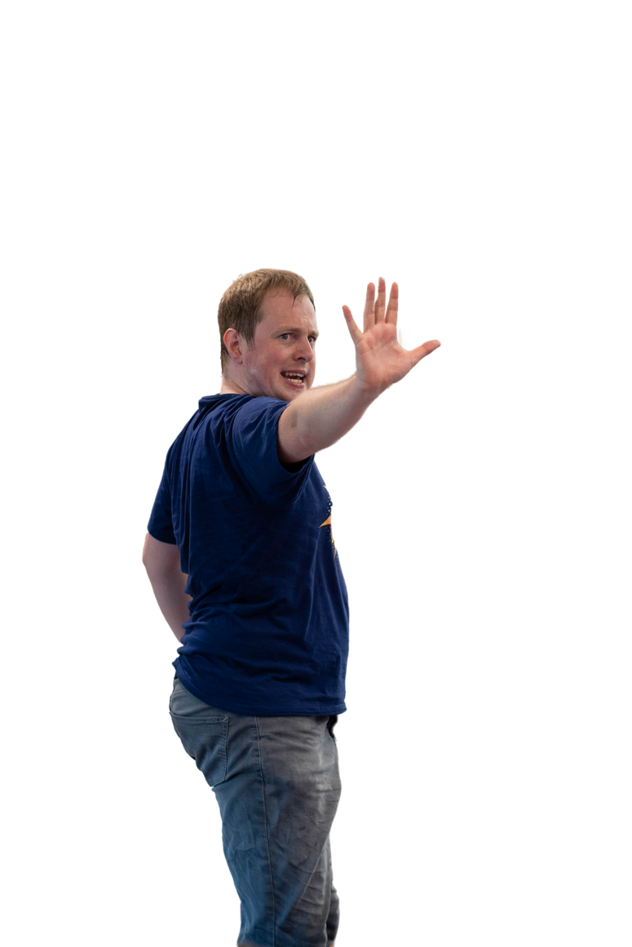

All About CLUNK!
CHARACTERS
In small groups or pairs, answer the following
Who did we meet?
What did they do?
Where did they go?
When did this happen?
Why did the character feel or act the way they did?
How did they make us feel, did we like then or not?
Which character did you like the best?
What made them your favourite?
Is there anything you’d like to know about this character that wasn’t told in the show?
3.

Slide 13
All About CLUNK!
PLOT
In small groups or pairs, answer the following
Who did the story follow?
What was the story about?
Where did the story take place?
When was the story set?
Why did certain actions happen?
How did it make us feel overall?
How did specific moments, make us fee?
like when Clunk fell out Andy’s ear.
when Andy wakes up after the electrocution.
4.

Slide 14
All About CLUNK!
OVERALL PERFORMANCE
In small groups or pairs, answer the following
What did the show look like?
How did the show make us feel?
How was the show presented?
Did you like it or not – can you explain why?
Did anything surprise you in the performance?
Did the story remind you of anything that you have read, seen or heard before?
5.

Slide 15
All About CLUNK!
CHALLENGE TIME
In small groups or pairs...
You have 20 minutes to rehearse in a group / pairs and then present it back to the class.
Recreate the main story points in less than 2 minutes.
HINTS
Start by agreeing on at least 5 key points in the story.
Make them into ‘frozen pictures’.
Then, the ‘frozen pictures’ can move from one image to another.
After you have completed these steps, you can also add dialogue.
6.

Slide 16
Making The Impossible... Possible
Task 1
1. What does ‘impossible’ mean?
If an action or event is impossible, it cannot happen or be achieved
An impossible situation is extremely difficult to deal with or solve:
2. As a whole class discuss ‘impossible’ scenarios.
For example, eating lots of Doritos will turn your skin orange.
7.

Slide 17

Making The Impossible...Possible
Task 2
1. In pairs, write down 3 ‘impossible’ scenarios.
2. Pass your 3 ‘impossible’ scenarios to another pairing / group.
They’re going to try and solve it!
Share your creative problem solving solutions with the class.
8.

Slide 18

Onomatopoeia Stories
Task 1
1. What does ‘onomatopoeia’ mean?
It is a word that looks like the sound it makes.
We can almost hear those sounds as we read.
/ Zap
For example :
/ Crash
Boom
2. As a whole class can you give more examples?
HINT
Think of the words you would see in bold in a comic book.
9.

Slide 19
Onomatopoeia Stories
Task 2
Pick one of the onomatopoeia words. Using this, write a short story.
For example,
C
L
U
N
K
Clair enjoys school.
Lucky for her, she sits next to her best friend.
Under their desk is a place they hide their sweets.
No one else knows it’s there apart from them.
Knowledge is power!
10.

Slide 20
T.V Time
Task 1
1. What does ‘synopsis’ mean?
a brief summary or general survey of something.
When discussing a play, film, or book it is an outline of the plot.
The synopsis for CLUNK! is
CLUNK! . . .
....a shiny, heavy thing falls out of Andy's ear during class. What is it? He and his Gran never keep secrets from each other, but Andy makes an exception with the weird ear thing. He keeps it in his pocket – secret.
Andy lives with his Gran above her video shop. They tell each other everything, until one day they don't and bad things start to happen. Turns out Gran has been keeping things to herself too, big, important things. Andy starts to wonder if his secret ear thing caused all this, or might it save them all?
11.

Slide 21
T.V Time
Task 1
2. Think about your favourite T.V show, film or book.
Write a synopsis about it and share it with your friend.
HINTS
Keep it short, snappy and to the point.
Tell the reader who the main character is, and any other characters that may feature.
Andy and Gran
Tell the reader what the main characters situation is, what happens to them to start the story?
...a shiny, heavy thing falls out of Andy's ear during class.
12.

Slide 22
T.V Time
HINTS
Tell the reader about obstacles that the main character will have to overcome. This could also include conflicts that they have with other characters and / or characters who help them.
Andy lives with his Gran above her video shop. They tell each other everything, until one day they don't and bad things start to happen. Turns out Gran has been keeping things to herself too, big, important things. Andy starts to wonder if his secret ear thing caused all this, or might it save them all?
13.

Slide 23
T.V Time
Task 2
Now it’s time for a crossover!
Using your favourite T.V show, film or book as the start of your story, you are now going to add you and your friends into the adventure.
Think about:
Who is the main character now?
What role you might have in the story, and what role does the original main character have?
Do you help the main character, are you a ‘villain’ to the main character?
What happens to the story now that you and your friends are involved?
Where does the story take place?
Where does it start and end? Where do they visit?
Why do you decide to do what you do?
When does the story take place?
What time is it? What year is it? What day is it?
14.

Slide 24
Follow us and share your work using #VFCLUNK and #VFCreativeLearning
www.visiblefictions.co.uk

Slide 25
Let’s Be Friends!
Aim:
To explore what it means to be a good friend.
Outcome:
To find personality traits we like about ourselves.
To find personality traits we look for in a friend.
To understand and know what trusted adults we have in our lives. These are adults we feel comfortable with to talk to about our worries.
www.visiblefictions.co.uk

Slide 26
Traits of a Friend
1. As a class, discuss traits that we would look for in a friend.
for example,
Fun /
Supportive...
Respectful /
Kind /
Honest /
2. What makes you a good friend? Write down 3 of your best traits.
3. Now, ask your friend why they are friends with you.
What do they think 3 of your best traits are?
Are they the same? If not, do you agree with what your friend has said?
Are you surprised by their answers?
1.

Slide 27
Your Best Pal
In pairs or as a small group, you’re going to create a ‘best pal’ for Andy.
We’re not replacing the relationship he had with his Gran, we’re just giving him a friend at school, or where he now lives who will support him, and who he can trust and have fun with.
2.

Slide 28

Your Best Pal
Get a big piece of paper, and a pen / pencil.
Place it on the floor and draw around your partner / someone in your group.
As a group, give this person:
a name
age
favourite food
favourite song
favourite T.V show / film / book.
Write this in the top right corner.
3.

Slide 29
Your Best Pal
Inside the silhouette, write the traits that you think they will need to be Andys best pal.
Are there any traits you have that could help Andy?
Fun
Respectful
Honest
Supportive
Kind
4.

Slide 30
Your Best Pal
Outside the silhouette , write down ways in which they could they help Andy.
Write down a situation where a friend helped you,
or you helped them.
Always invite them to movie night
Share snacks
Fun
Respectful
Honest
Ask how they’re feeling
Supportive
Kind
Playing football and when they fell down I helped them back up
5.

Slide 31
Your Best Pal
Inside the silhouette write down what Andy and his new best friend have in common.
Always invite them to movie night
Music
Share snacks
Fun
Respectful
School
Honest
Ask how they’re feeling
Food
Supportive
Kind
religion
Playing football and when they fell down I helped them back up
football
6.

Slide 32
Your Best Pal
Inside the silhouette write down what Andy and his new best friend have that makes them different.
Always invite them to movie night
Music
Share snacks
Home
Fun
Respectful
School
Pets
Honest
Ask how they’re feeling
Food
Supportive
Kind
Movies
religion
Playing football and when they fell down I helped them back up
football
maths
7.

Slide 33
Your Best Pal
Outside the silhouette, write down how they became friends with Andy.
Sat beside each other in school
They don’t like the same movies, but still watch things together
Always invite them to movie night
Music
Share snacks
Home
Fun
Respectful
School
Pets
Honest
Ask how they’re feeling
Food
They both like the same food so would talk about their favourite snacks.
Supportive
Kind
Movies
They were put on the same football team
religion
Playing football and when they fell down I helped them back up
football
maths
8.

Slide 34
A Trusting Hand
We all need people we trust and can tell our secrets and worries to.
It’s important that we keep in mind who these people are to us.
9.

Slide 35

A Trusting Hand
Get a piece of paper, and a pen / pencil.
Draw around your hand and write your name in the middle.
Suzie
10.

Slide 36
A Trusting Hand
In each finger, write down the name of someone you trust and something you would trust them with. This can be a big thing or a small thing.
There is no right or wrong answer. It is all about who YOU feel comfortable with to talk to and what you can talk to them about.
Remember, this work may be seen so don’t write down anything you don’t want everyone to know.
You should keep it unclear or something that can be understood in different ways.
Gran - EVERYTHING
Uncle Dougie - family
Laura - friends
Malena - friends
Suzie
Ms Brown - school
11.

Slide 37








A Trusting Hand
Decorate your hand with colours, symbols, objects... ANYTHING that makes you, you.
Gran - EVERYTHING
Uncle Dougie - family
Laura - friends
Malena - friends
Suzie
Ms Brown - school
12.

Slide 38
Follow us and share your work using #VFCLUNK and #VFCreativeLearning
www.visiblefictions.co.uk

Slide 39
Let’s Evaluate
Aim:
To share your opinions, thoughts and feeling on the performance of CLUNK!
Outcome:
To show I understand what I have seen and heard by answering questions.
To write an informative and opinionated review of the performance.
To share relevant information with my class and reader.
www.visiblefictions.co.uk
Notes:
Literacy and English
Listening and talking
� I can select ideas and relevant information, organise these in an appropriate way for my purpose and use suitable vocabulary for my audience. LIT 2-06a
� I can show my understanding of what I listen to or watch by responding to literal, inferential, evaluative and other types of questions, and by asking different kinds of questions of my own. LIT 2-07a

Slide 40

Let’s Reflect
1. How many stars would you give this performance?
2. Why did you give it that many stars?
3. What did you enjoy the most? Why?
4. What did you enjoy the least? Why?
1.

Slide 41


Let’s Write A Review
Your local newspaper has been informed that you’ve seen Visible Fictions’ performance of CLUNK! and ask for a review.
What do you tell them?
2.
Click on the newspaper to read Joyce McMillan’s review of CLUNK! in The Scotsman

Slide 42
Let’s Write A Review
When writing a review, include:
The name of the production
The name of the theatre company
The venue (where you saw the show)
The date of the performance.
3.

Slide 43
Let’s Write A Review
When writing a review, include:
A summary of the performance but avoid spoilers!
4.

Slide 44
Let’s Write A Review
When writing a review, include:
Your opinion – what you really thought of the show.
People are interested in your opinion, but remember, people can disagree with you.
Justify why you’re saying what you’re saying but remember, we all have feelings so don’t be mean about it.
You could answer questions like:
How did you feel at the start and then the end of the performance?
Did the performance make you think of or feel anything?
What do you think about the characters / the plot / the acting / the movement.
5.

Slide 45
Let’s Write A Review
When writing a review, include:
Strong details
If you thought something was amazing, explain WHY?
If you thought it was boring, explain WHY?
6.

Slide 46
Let’s Write A Review
When writing a review, include:
If you recommend the reader to go and see the production?
7.

Slide 47
Your Time To Shine
If you were the director, writer or actor what would you change about the story?
Is there another way this could have been shown?
How?
Can you work together to make the changed version?
Did you have questions from the play that were left unanswered for you?
Can you find a way to answer them?
If you were to perform this what might you do differently?
8.

Slide 48
Follow us and share your work using #VFCLUNK and #VFCreativeLearning
www.visiblefictions.co.uk

Slide 49
Thank You!
From Visible Fictions
Dougie Irvin
Laura Penny
Sophie Ochojna
Suzie Bell
Julie Brown
Malena Persson
Jason Dyer
Artistic Director
Producer
Marketing and Development Manager
Learning and Engagement Co-Ordinator
Project Manager
Social Media Officer
Fundraising Officer

